Slide 1
Microsoft + Docker
Docker for Linux
Docker for Windows
DockerHub + Azure

Slide 2
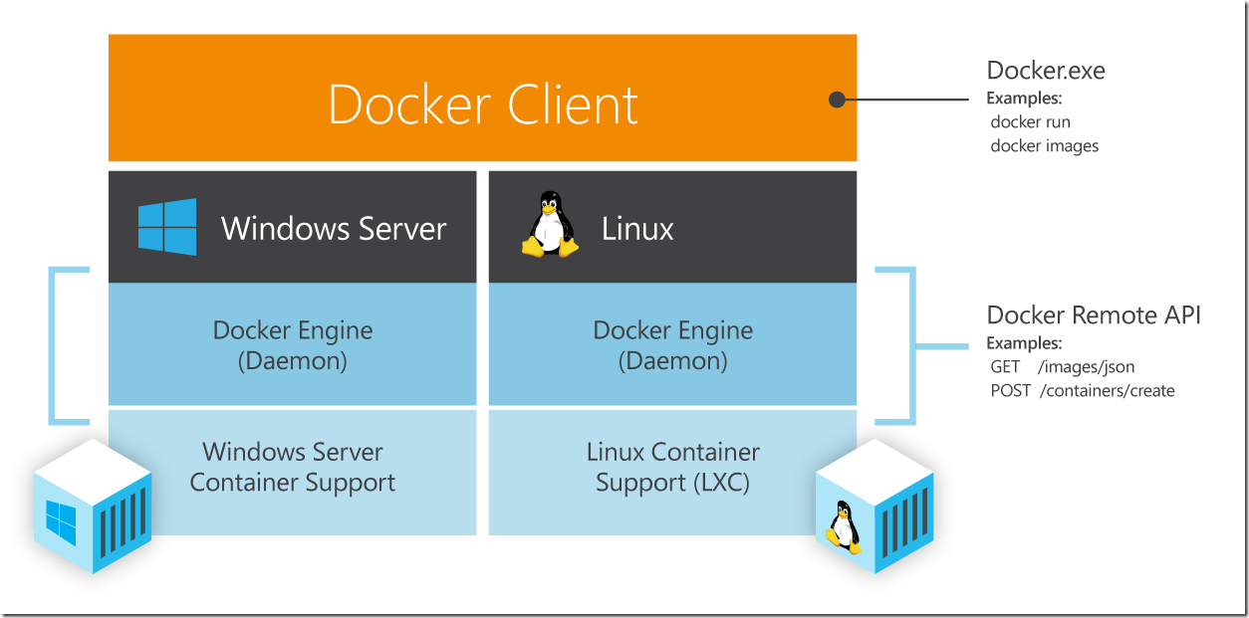
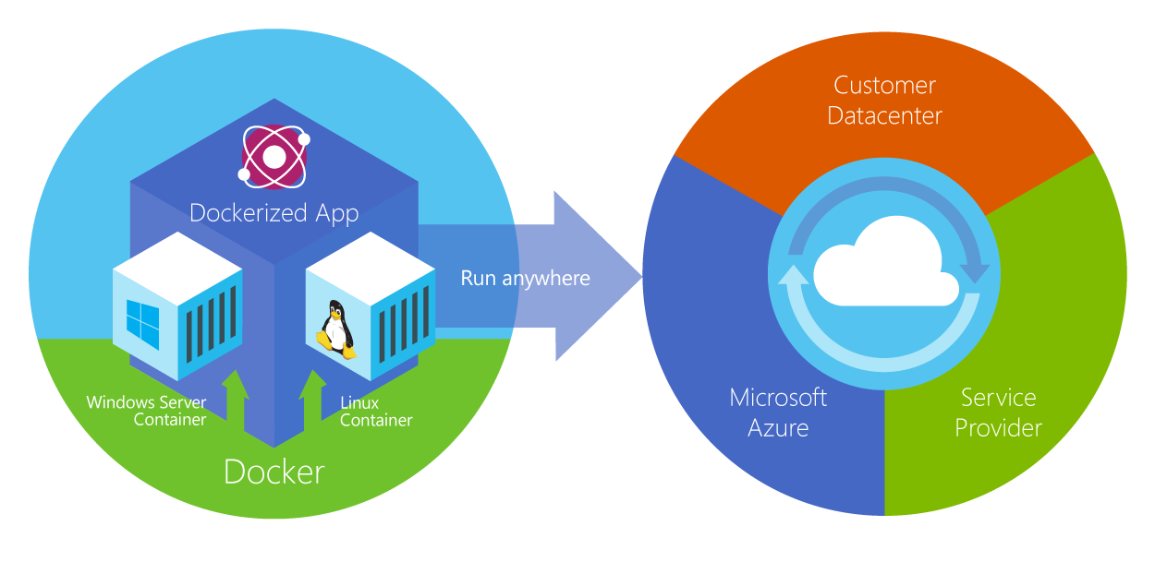
Docker Integration Goals
Meet developers where they are – make Docker clients work for Azure
Docker API as the primary management interface for Windows/Linux containers
DockerHub as the only public repo for container images
Docker hub content will show up in Azure Marketplace
Content subject to Microsoft NDA

Slide 3
Announcing CoreOS support in Azure
Container-optimized Linux distribution
Minimal memory footprint

Slide 4
Docker + Azure = More
Market place ecosystem
…
Region 1
Region n
Service Orchestrators, Scalers and Brokers
Service Orchestrators, Scalers and Brokers
…
Your “Dockerized” Cloud service
Datacenter 1
Datacenter n
Datacenter network
Location independent | Composable | Portable
Azure Global Infrastructure Control Plane (management.azure.com)
Cluster
1
Cluster
2
…
Cluster
n
Web | Mobile | Gaming | Media | Analytics | Data | Identity
Compute | Storage | Networking
Azure Global Infrastructure Data Plane
Private Cloud | Public Cloud | Hybrid Cloud
Content subject to Microsoft NDA

